Slide 1

Daniel Segan
dsegan@me.com |  @dsegan |  danielsegan

Slide 2
About me
Director of App Innovation @ CloudScale
20+ years in the MS Partner Space
Started way back in the day… before .Net
ASP.Old, VB6, C++/MFC/COM, C
Got started on Unix, SunOS/Solaris
A lot of work with SharePoint
Have been a bit of a skeptic and curmudgeon about EF, and I don’t claim to be an expert
MS Partner based in NYC & LA/SoCal

Slide 3
Overview
Brief history of Entity Framework
EF Core vs EF 6
Key Concepts
Demos
Set up tooling
Create a DB, fill it with data, and query
Make changes to the DB with C# code
Create Relationships
Reverse Engineering

Slide 4
Questions
Who’s using .Net Core?
Who’s using EF6/Core, and what types of applications (Web, Windows, etc)?
Who’s using other ORMs?
What do you think of EF6/Core?
What DB platforms are you using?
Visual Studio 2017 or VSCode?

Slide 5
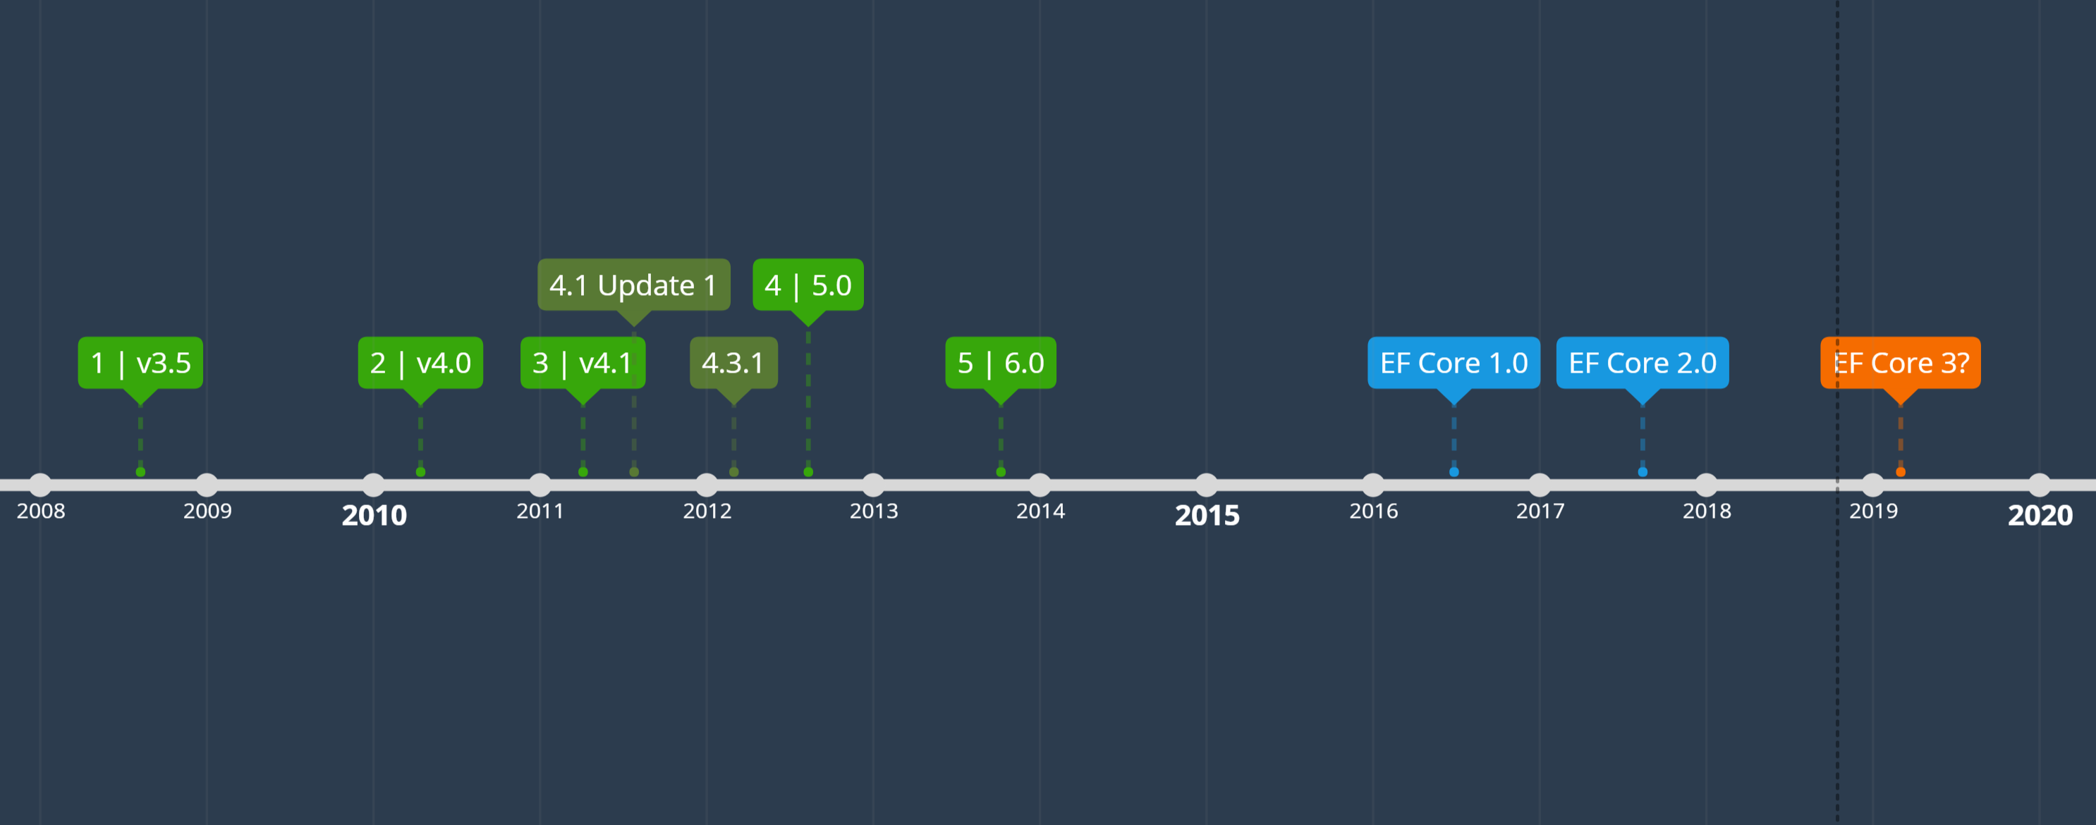
History: Entity Framework v1 – v6
Notes:
From Wikipedia:
1) The first version of Entity Framework (EFv1) was included with .NET Framework 3.5 Service Pack 1 and Visual Studio 2008 Service Pack 1, released on 11 August 2008. This version was widely criticized, even attracting a 'vote of no confidence' signed by approximately one thousand developers.^{[3]}
The second version of Entity Framework, named Entity Framework 4.0 (EFv4), was released as part of .NET 4.0 on 12 April 2010 and addressed many of the criticisms made of version 1.^{[4]}
2) A third version of Entity Framework, version 4.1, was released on April 12, 2011, with Code First support.
3) A refresh of version 4.1, named Entity Framework 4.1 Update 1, was released on July 25, 2011. It includes bug fixes and new supported types.
The version 4.3.1 was released on February 29, 2012.^{[5]} There were a few updates, like support for migration.
4) Version 5.0.0 was released on August 11, 2012^{[6]} and is targeted at .NET framework 4.5. Also, this version is available for .Net framework 4, but without any runtime advantages over version 4.
5) Version 6.0 was released on October 17, 2013^{[7]} and is now an open source project licensed under Apache License v2. Like ASP.NET MVC, its source code is hosted at GitHub using Git.^{[8]} This version has a number of improvements for code-first support.^{[9]}
Microsoft then decided to modernize, componentize and bring .NET cross-platform to Linux, OSX and elsewhere, meaning the next version of Entity Framework would be a complete rewrite.^{[10]} On 27 June 2016 this was released as Entity Framework Core 1.0, alongside ASP.Net Core 1.0 and .Net Core 1.0.^{[11]} It was originally named Entity Framework 7, but was renamed to highlight that it was a complete rewrite rather than an incremental upgrade and it doesn't replace EF6.^{[12]}
EF Core 1.0 is licensed under Apache License v2, and is being built entirely in the open on GitHub. While EF Core 1.0 shares some conceptual similarities with prior versions of Entity Framework, it is a completely new codebase designed to be more efficient, powerful, flexible, and extensible, will run on Windows, Linux and OSX, and will support a new range of relational and NOSQL data stores.^{[10]}
EF Core 2.0 was released on 14 August 2017 along with Visual Studio 2017 15.3 and ASP.NET Core 2.0 ^{[13]}

Slide 6
My beef with EF
Initial release
Other tools
Confusing Tooling
Code First? Model First? DB First? PowerTools?
Early projects gone wrong
Sometimes easier to just deal with SQL?
Notes:
LINQ to SQL vs Early EF
nHibernate was already out. Hibernate was popular in the Java world
Which tools were the best approach, seemed to offer different outcomes and tradeoffs – no unified stance
Sales Force connector project

Slide 7

EF Core
Lightweight
Extensible & Modular
Cross-Platform
Similar developer experience
Entirely new codebase
Not as mature (maybe a good thing)
Some features missing; Some deprecated
SQL Generation has changed

Slide 8
EF6 vs. EF Core
Deprecated/Missing Features
Model-first
Features not implemented yet
Lazy Loading prior to 2.1
All-New features!
NoSQL / Cosmos DB
Comprehensive Comparison

Slide 9
History: Entity Framework Core v1 – v2.1
V1 (June ’16)
Initial release missing a lot of stuff, maybe not ready for production but offered hope
V2 (Aug ‘17)
Most accounts suggest it’s ready to use
Queries
LINQ Queries translation is better
Global Query Filters
Explicitly Compiled Queries
Mapping
Value Object
Table Splitting (1 Entity : Multiple Tables
Other
String interpolation in raw SQL
Better logging
V2.1 (May ‘18)
Group By
Lazy Loading
Update (Code) from DB
Oracle* / Cosmos DB Provider*
Notes:
V2 Improvements
LINQ Queries are better
In previous versions, many of the LINQ query Methods were evaluated on the results. In this version many of these are evaluated in the DB

Slide 10
Roadmap: Entity Framework Core v2.2 & v3
EF Core v2.2 will be next minor version
small release
before end of year 2018 (currently preview)
EF Core v3 will be the next major version
Synchronized with .Net Core and ASP.Net Core schedule
Expected Q1 – Q2 2019

Slide 11
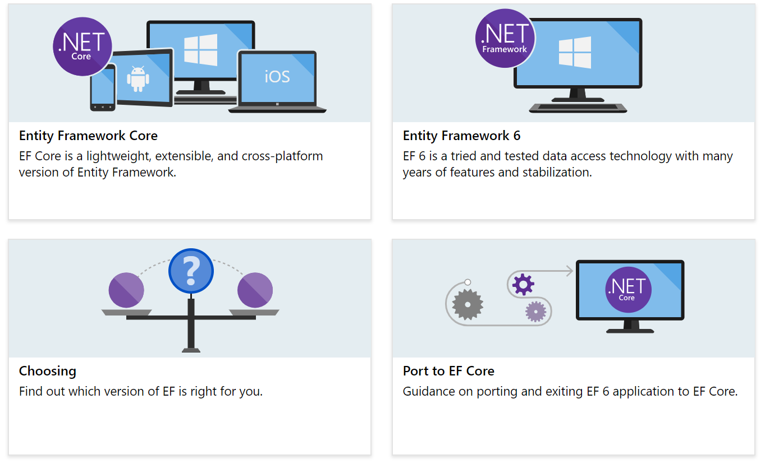
Notes:
Microsoft Provides some guidance on approach
The general consensus/wisdom would be to use EF Core for net new stuff

Slide 12

EF Core DB Support
Microsoft SQL Server (makes a lot of sense…)
SQLite
EF Core In-Memory
MyCAT
Postgress
MySQL
Firebird
DB2/Informix
Oracle*
Cosmos DB*
Jet/MS Access (not even joking!)
https://docs.microsoft.com/en-us/ef/core/providers/
Notes:
There are multiple implementations of the Oracle Provider
There are multiple MySQL / Maria DB implementations
Jet Only works on Windows Machines
Cosmos DB provider in preview

Slide 13
Some EF Core Alternatives…
ORM
DevExpress XPO
LLBLGen
*NHibernate
Dapper
Massive
Peta Poco
LINQ to DB
Micro ORM
Artisan.ORM
EF6
Notes:
EF is not the only option. The alternatives are generally categorized in two areas : ORM and Micro ORM
Micro ORMs are more lightweight. Some of the ones listed are actually a reaction/response to how heavy EF6 was.

Slide 14
EF Core Concepts
DbContext
Model
Data Management
Migrations

Slide 15
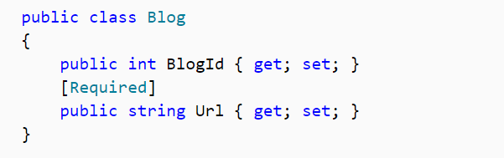
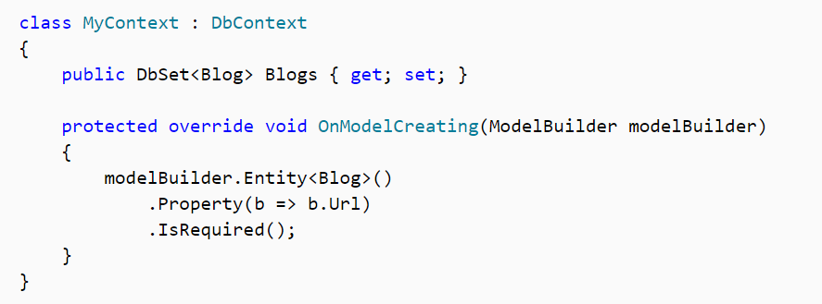
Convention + Configuration
Convention
Conventions define how the framework will work if no configuration is supplied
Data Annotation
Declarative configurations
Override conventions
Fluent API
Imperative configuration
Override Conventions, and Data Annotations
Annotation
Fluent API

Slide 16
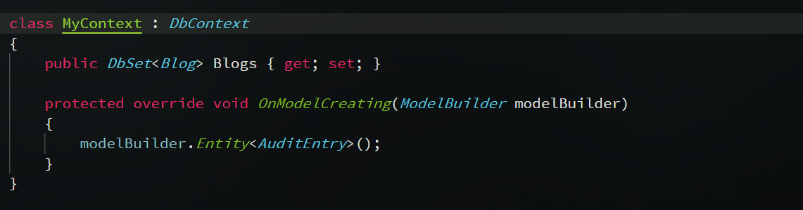
DBContext
Context for all operations on the database
Based on provider
Manages connections to DB
Manages state, transactions, concurrency
Notes:
Configuration supplements and overrides convention

Slide 17
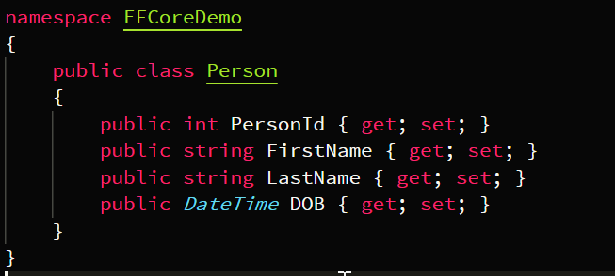
Models
Entity Class is a POCO
By convention, public properties with a getter and a setter will be included in the model.
Properties can be excluded via Annotation or Fluent API
Notes:
Configuration supplements and overrides convention

Slide 18
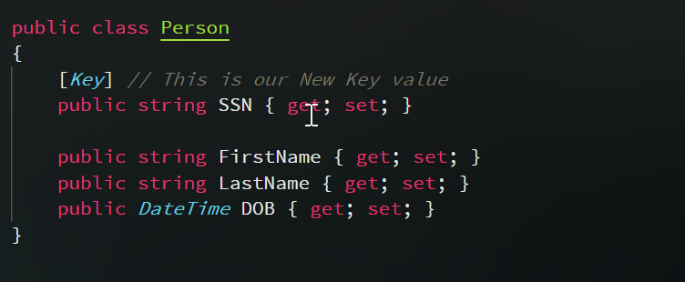
Models: Keys
Key -> Primary Key
Conventions
Id or <type name> Id
Id
PersonId
Data Annotation
[Key]
Fulent API
modelBuilder.Entity<Person().HasKey(p => p.ssn)
Good way to do composite keys
Notes:
Configuration supplements and overrides convention

Slide 19
Models: Value Generation
Types
No Value Generation
On Add
On Add or Update
Provider Specific Implementations & Custom Implementations
Values might be generated by DB or EF
Common uses
Primary / Alternate Keys
Last Updated
Versioning Schemes
Notes:
SQL server has rules about GUIDs and
For DB Providers that

Slide 20
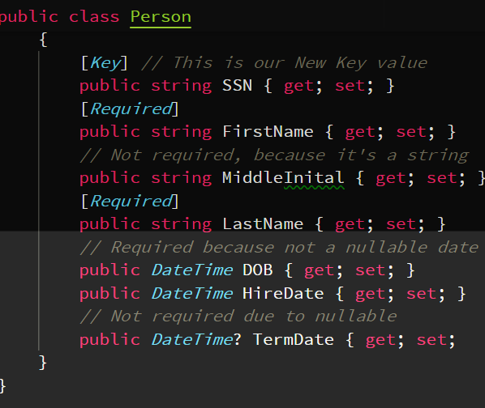
Models
Required / Optional
By convention, CLR types which can contain null are optional
E.g. string, or nullable types: int?, DateTime?, etc
Data Annotations & Fluent to make required
Max Length
Applies to things like string, byte[]
Provider based implementation
SQL (string: nvarchar(max) or (450) for key
Data Annotations & Fluent to modify
Notes:
SQL Server uses nvarchar(max) for string, or nvarchar(450) if it’s a key
Great for devs, not very good for DB

Slide 21
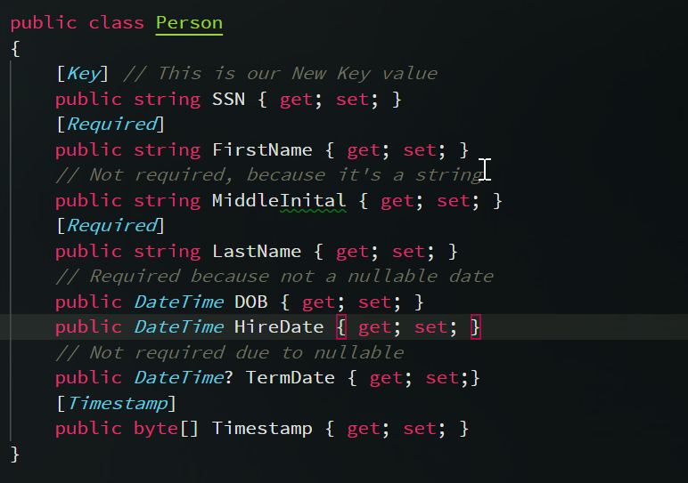
Models: Advanced Topics
Indices
Added through Fluent API
Concurrency
E.g. Timestamp
Shadow Properties
Properties not on the entity POCO class, but in the DB
Owned Entities
Only navigation properties (EF C2)
Notes:
SQL Server uses nvarchar(max) for string, or nvarchar(450) if it’s a key
Great for devs, not very good for DB

Slide 22
Principle Entity
Parent (Invoice)
Dependent Entity
Child (Invoice Line Item)
Principal Key
Primary Key on parent
Foreign Key
Basis of relationship
Property on the child that points to the parent
Navigation Property – Reference to related entity
Collection
Many related entities (line item)
Reference
Single entity
Inverse
The opposite side of the relationship
Invoice
(Parent)
Line Item (Dependent)
Line Item (Dependent)
Line Item (Dependent)
Line Item (Dependent)
Notes:
SQL Server uses nvarchar(max) for string, or nvarchar(450) if it’s a key
Great for devs, not very good for DB

Slide 23
Data/Model Management
Value Conversion
Property values to be converted when reading from or writing to the database.
E.g. encryption
Data Seeding
Populate DB with initial data
Fluent API .HasData()
Notes:
SQL Server uses nvarchar(max) for string, or nvarchar(450) if it’s a key
Great for devs, not very good for DB

Slide 24
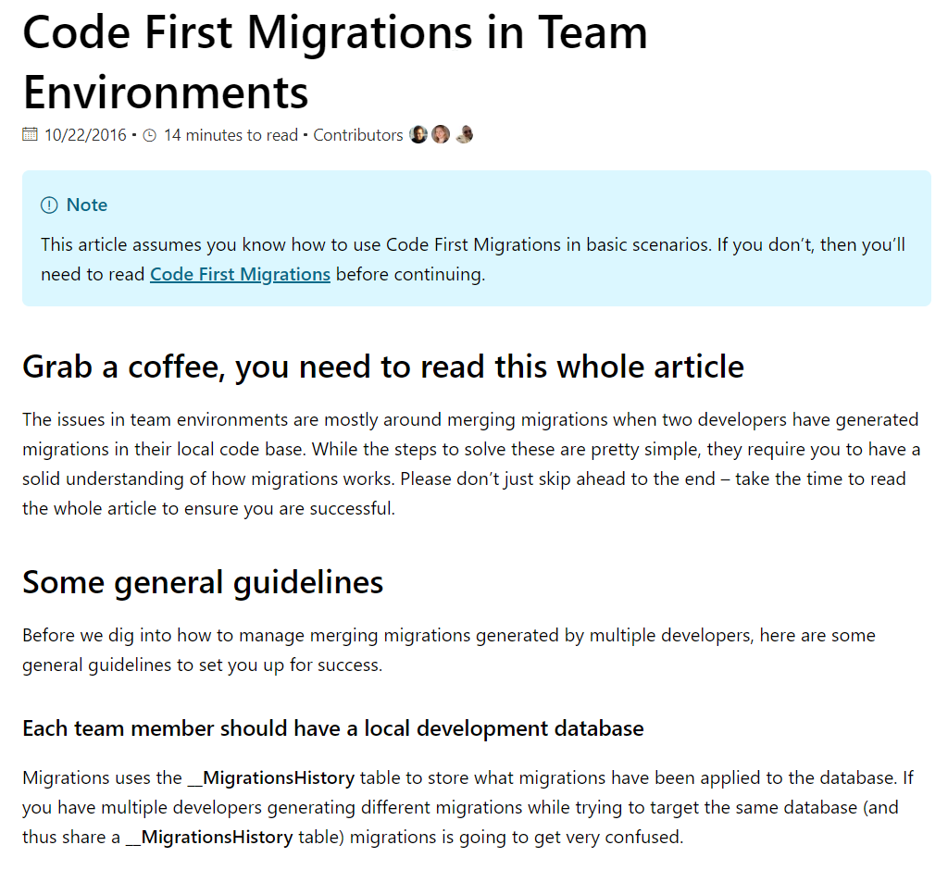

EF6 Migrations

Slide 25
Migrations
Operation | PS | CLI
Create init, or create new migration (based on last) | Add-Migration | dotnet ef migrations add
Apply | Update-Database | dotnet ef database update
Remove Migration not yet applied | Remove-Migration | dotnet ef migrations remove
Revert DB | Update-Database LastGoodMigration | dotnet ef database update LastGoodMigration
Generate Scripts | Script-Migration | dotnet ef migrations script
init
People Entity Added
Product Entity Added, Product Job Relationship added
Job Entity Added
Notes:
SQL Server uses nvarchar(max) for string, or nvarchar(450) if it’s a key
Great for devs, not very good for DB

Slide 26
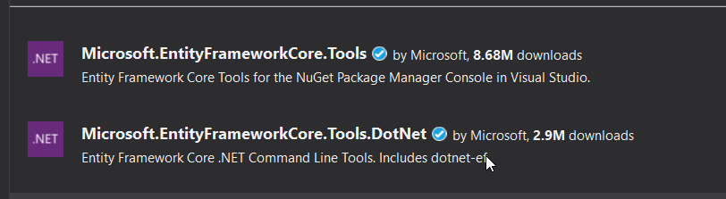
EF Core Tooling: CLI / VS Code
Same tools 2 interfaces
Notes:
Some articles on performance tuning:
https://www.thereformedprogrammer.net/entity-framework-core-performance-tuning-a-worked-example/

Slide 27
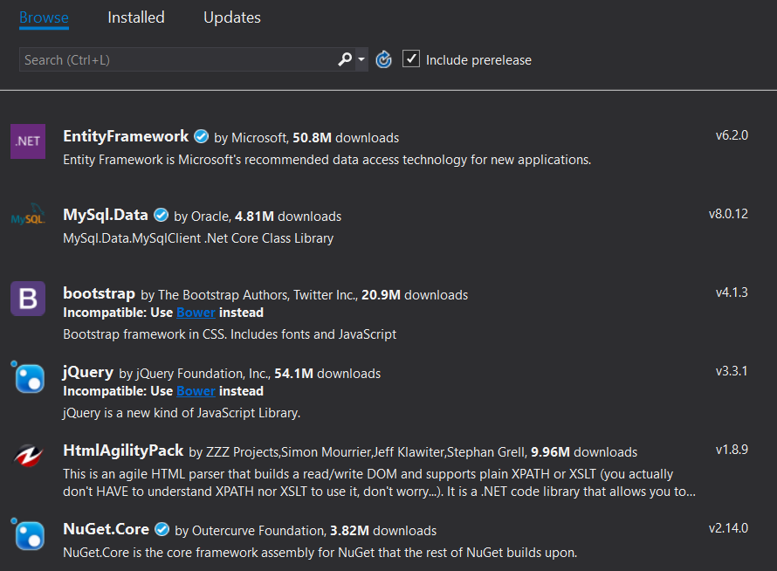
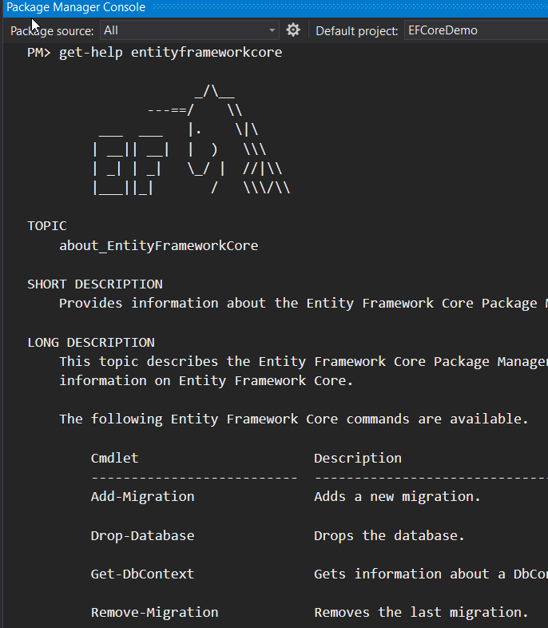
EF Core Tooling: Visual Studio
EF Core Package
Database Provider
Tools
Design Package
Notes:
Some articles on performance tuning:
https://www.thereformedprogrammer.net/entity-framework-core-performance-tuning-a-worked-example/

Slide 28
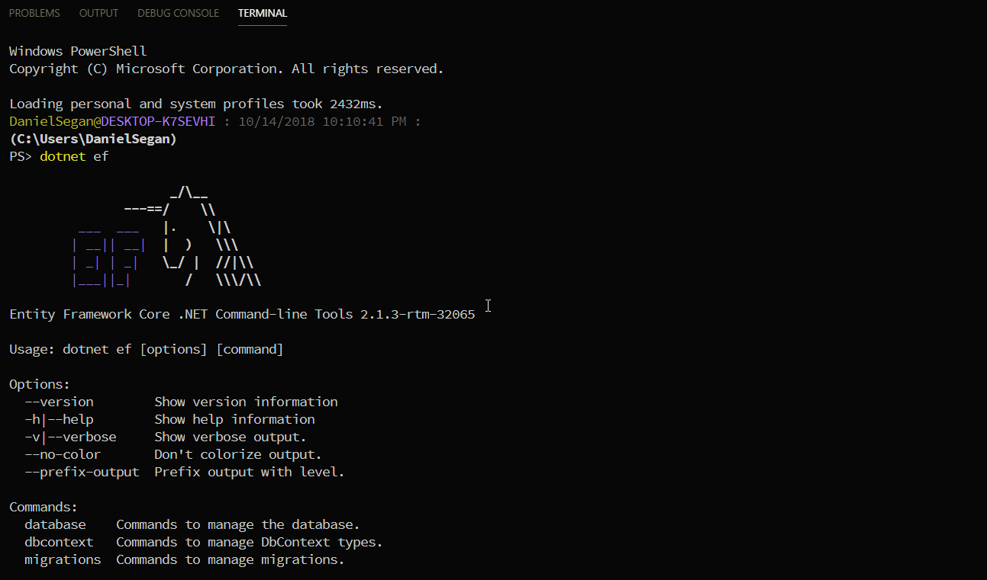
EF Core Tooling: VS Code
Notes:
Some articles on performance tuning:
https://www.thereformedprogrammer.net/entity-framework-core-performance-tuning-a-worked-example/

Slide 29
Demo 1: Tooling
Visual Studio 2017
VS Code & CLI

Slide 30
Demo 2: Basics
Create a basic model and generate the DB
Relationships
Save Data
Migrations

Slide 31
Demo 3: Reverse Engineering
Generate code from existing DB

Slide 32
Resources
Julie Lerman
Pluralsight Courses, Talks, Twitter etc.
MSDN Magazine
Tools & Extensions
.NET Blog
Entity Framework Tag
GitHub
aspnet/EntityFrameworkCore
EF Core Roadmap
Notes:
Julie is one of the leading experts on EF. If you have looked into EF at all, you probably know her name. Her pluralsight courses are great and her content is my go-to for any training or deep info. She’s also big on domain driven design.
The .NET Blog has EF specific tags.
Project Site on GitHub
PowerTools

Slide 33
Daniel Segan
dsegan@me.com |  @dsegan |  danielsegan

